Slide 1
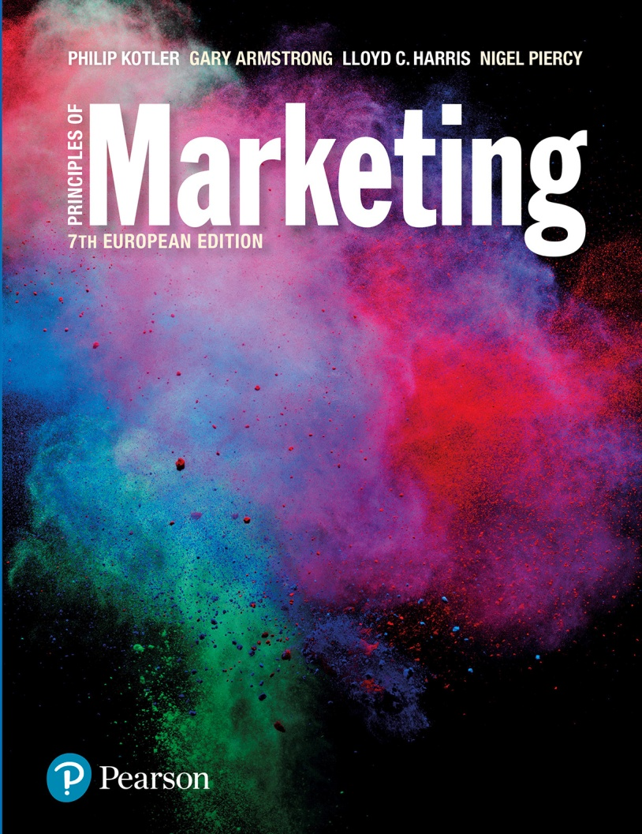
Principles of Marketing
7th European edition
Part 04
Extending marketing
Chapter 18
Creating competitive advantage

Slide 2
Creating competitive advantage
Topic outline
Competitor analysis
Competitive strategies
Balancing customer and competitor orientations.

Slide 3
Today’s companies
Competitive advantages require delivering more value and satisfaction to target consumers than competitors do.
Competitive marketing strategies are how companies analyse their competitors and develop value-based strategies for profitable customer relationships.

Slide 4
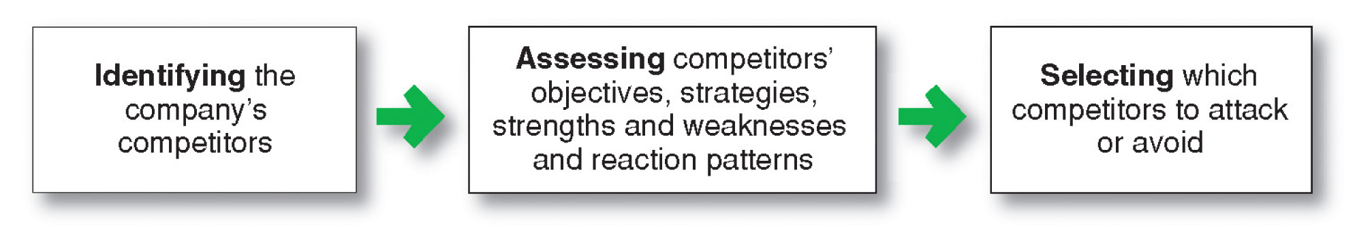
Competitor analysis
Competitor analysis is the process of identifying key competitors; assessing their objectives, strategies, strengths and weaknesses and selecting which competitors to attack or avoid.
Notes:
Figure 18.1 Steps in analysing competitors

Slide 5
Competitor analysis (Continued)
Identifying competitors
Competitors can include:
All firms making the same product or class of products.
All firms making products that supply the same service.
All firms competing for the same consumers.

Slide 6
Competitor analysis (Continued)
Assessing competitors
Competitor’s objectives
Competitor’s strategies
Profitability
Market share growth
Cash flow
Technological leadership
Service leadership
Strategic group offers the strongest competition
Notes:
Notes to Instructor:
A strategic group is a group of firms in an industry following the same or a similar strategy in a given target market. For example, in the major appliance industry, General Electric and Whirlpool belong to the same strategic group. Each produces a full line of medium-price appliances supported by good service. In contrast, Sub-Zero and Viking belong to a different strategic group. They produce a narrower line of higher quality appliances, offer a higher level of service and charge a premium price.

Slide 7
Competitor analysis (Continued)
Assessing competitors
Competitor’s strengths and weaknesses
What can our competitors do?
Benchmarking
Estimating competitor’s reactions
What will our competitors do?

Slide 8
Competitor analysis (Continued)
Selecting competitors to attack and avoid
Strong or weak competitors
Close or distant competitors
Good or bad competitors.
Notes:
Notes to Instructor:
Weak versus strong competitors
Most companies prefer to compete against weak competitors. This requires fewer resources and less time. But in the process, the firm may gain little. You could argue that the firm also should compete with strong competitors in order to sharpen its abilities. Moreover, even strong competitors have some weaknesses and succeeding against them often provides greater returns.
Close versus distant competitors
Most companies will compete with close competitors—those that resemble them most—rather than distant competitors. Thus, Nike competes more against Adidas than against Timberland or Keen. And Target competes against Wal-Mart rather than Neiman Marcus or Nordstrom. At the same time, the company may want to avoid trying to ‘destroy’ a close competitor.
Good versus bad competitors
Good competitors play by the rules of the industry. Bad competitors, in contrast, break the rules. They try to buy share rather than earn it, take large risks and play by their own rules.

Slide 9
Competitor analysis (Continued)
Selecting competitors to attack and avoid
Customer value analysis determines the benefits that target customers value and how customers rate the relative value of various competitors’ offers.
Identification of major attributes that customers value and the importance of these values.
Assessment of the company’s and competitors’ performance on the valued attributes.

Slide 10
Competitor analysis (Continued)
Selecting competitors to attack and avoid
Rather than competing head to head with established competitors, many companies seek out unoccupied positions in uncontested market spaces.
This is called ‘blue ocean’ strategy, where there are no direct competitors.

Slide 11
Competitor analysis (Continued)
Designing a competitive intelligence system
Identifies competitive information and the best sources of this information.
Continually collects information.
Checks information for validity and reliability.
Interprets information.
Organises information.
Sends key information to relevant decision makers.
Responds to inquiries about competitors.

Slide 12
Competitive strategies
Approaches to marketing strategy
Entrepreneurial marketing involves visualising an opportunity and constructing and implementing flexible strategies.
Formulated marketing involves developing formal marketing strategies and following them closely.
Intrepreneurial marketing involves the attempt to re-establish an internal entrepreneurial spirit and refresh marketing strategies and approaches.

Slide 13
Competitive strategies (Continued)
Basic competitive strategies
Michael Porter’s four basic competitive positioning strategies
Overall cost leadership
Differentiation
Focus
Middle-of-the-roaders

Slide 14
Competitive strategies (Continued)
Basic competitive strategies
Overall cost leadership strategy:
A company achieves the lowest production and distribution costs and allows it to lower its prices and gain market share.

Slide 15
Competitive strategies (Continued)
Basic competitive strategies
Differentiation strategy is when a company concentrates on creating a highly differentiated product line and marketing program so it comes across as an industry class leader.
Focus strategy is when a company focuses its effort on serving few market segments well rather than going after the whole market.

Slide 16
Competitive strategies (Continued)
Basic competitive strategies
A company that pursued a clear strategy would achieve superior performance.
Companies without a clear strategy, ‘middle- of-the-roaders’, would not succeed.

Slide 17
Competitive strategies (Continued)
Basic competitive strategies
Michael Treacy and Fred Wiersema suggest companies can gain leadership positions by delivering superior value to their customers in three strategies or ‘value disciplines’:
Operational excellence
Customer intimacy
Product leadership.
Notes:
Notes to Instructor:
Treacy and Wiersema found that leading companies focus on and excel at a single value discipline, while meeting industry standards on the other two. Such companies design their entire value delivery network to single-mindedly support the chosen discipline.

Slide 18
Competitive strategies (Continued)
Basic competitive strategies
Operational excellence refers to a company providing value by leading its industry in price and convenience by reducing costs and creating a lean and efficient value delivery system.

Slide 19
Competitive strategies (Continued)
Basic competitive strategies
Customer intimacy refers to a company providing superior value by segmenting markets and tailoring products or services to match the needs of the targeted customers.

Slide 20
Competitive strategies (Continued)
Basic competitive strategies
Product leadership refers to a company providing superior value by offering a continuous stream of leading edge products or services. Product leaders are open to new ideas and solutions and bring them quickly to the market.

Slide 21
Competitive strategies (Continued)
Competitive positions
Market leader strategies
Market challenger strategies
Market follower strategies
Market nicher strategies
Notes:
Notes to Instructor:
Forty per cent of the market is in the hands of the market leader, the firm with the largest market share. Another 30 per cent is in the hands of market challengers, runner‑up firms that are fighting hard to increase their market share. Another 20 per cent is in the hands of market followers, other runner-up firms that want to hold their share without rocking the boat. The remaining 10 per cent is in the hands of market nichers, firms that serve small segments not being pursued by other firms.

Slide 22
Competitive strategies (Continued)
Competitive positions
Market leader is the firm with the largest market share and leads the market price changes, product innovations, distribution coverage and promotion spending.
Market challengers are firms fighting to increase market share.

Slide 23
Competitive strategies (Continued)
Competitive positions
Market followers are firms that want to hold onto their market share.
Market nichers are firms that serve small market segments not being pursued by other firms.

Slide 24
Competitive strategies (Continued)
Market leader strategies
Expand total demand
Protect their current market
Expand market share.
Notes:
Notes to Instructor:
A leader’s life is not easy. It must maintain a constant watch. Other firms keep challenging its strengths or trying to take advantage of its weaknesses. The market leader can easily miss a turn in the market and plunge into second or third place. A product innovation may come along and hurt the leader. The leader might grow arrogant or complacent and misjudge the competition. Or the leader might look old-fashioned against new and peppier rivals.

Slide 25
Competitive strategies (Continued)
Market leader strategies
Expanding total demand
Expand total demand by developing:
New users
New uses
More usage of its products.

Slide 26
Competitive strategies (Continued)
Market leader strategies
Protecting market share
Protect current market by:
Fixing or preventing weaknesses that provide opportunities to competitors.
Maintain consistent prices that provide value.
Keep strong customer relationships.
Continuous innovation.

Slide 27
Competitive strategies (Continued)
Market leader strategies
Expanding market share
Expand market share by:
Increasing profitability with increasing market share in served markets.
Producing high-quality products.
Creating good service experiences.
Building close relationships.

Slide 28
Competitive strategies (Continued)
Market challenger strategies
Challenge the leader with an aggressive bid for more market share.
Second-mover advantage: challenger observes what has made the leader successful and improves on it.
Notes:
Notes to Instructor:
The text gives an excellent example of a market challenger:
Virgin Drinks took on the leaders head-on, launching its own cola, advertising heavily and trying to get into all the same retail outlets that stocked the leading brands. At Virgin Cola’s launch, Virgin CEO Richard Branson even drove a tank through a wall of rivals’ cans in New York’s Times Square to symbolise the war he wished to wage on the big, established rivals. However, Coke’s and Pepsi’s viselike grip on U.S. shelf space proved impossible for Virgin Drinks to break. Although Virgin Drinks is still around, it has never gained more than a 1 per cent share of the U.S. cola market.
Red Bull, by contrast, tackled the leaders indirectly. It entered the U.S. soft drinks market with a niche product: a carbonated energy drink retailing at about twice what you would pay for a Coke or Pepsi. It started by selling Red Bull through unconventional outlets not dominated by the market leaders, such as bars and nightclubs, where twenty-something's gulped down the caffeine-rich drink so they can dance all night. After gaining a loyal following, Red Bull used the pull of high margins to elbow its way into the corner store, where it now sits in refrigerated bins within arm’s length of Coke and Pepsi. In the United States, where Red Bull enjoys a 65 per cent share of the energy drink market, its sales are growing at about 35 per cent a year.

Slide 29
Competitive strategies (Continued)
Market follower strategies
Play along with competitors and avoid rocking the boat.
Copy or improve on leader’s products and programmes with less investment.
Bring distinctive advantages.
Keep costs and prices low or quality and services high.

Slide 30
Competitive strategies (Continued)
Market nicher strategies
Ideal market niche is big enough to be profitable with high growth potential and has little interest from competitors.
Key to market niching is specialisation.
Market
Customer
Product
Marketing mix.

Slide 31
Balancing customer and competitor orientations
Companies need to continuously adapt strategies to changes in the competitive environment
Competitor-centred company
Customer-centred company
Market-centred company.

Slide 32
Balancing customer and competitor orientations (Continued)
Competitor-centred company spends most of its time tracking competitors’ moves and market shares and trying to find ways to counter them.
Advantage is that the company is a fighter.
Disadvantage is that the company is reactive.

Slide 33
Balancing customer and competitor orientations (Continued)
Customer-centred company spends most of its time focusing on customer developments in designing strategies.
Provides a better position than competitor-centred company to identify opportunities and build customer relationships.

Slide 34
Balancing customer and competitor orientations (Continued)
Market-centred company spends most of its time focusing on both competitor and customer developments in designing strategies.

Slide 35
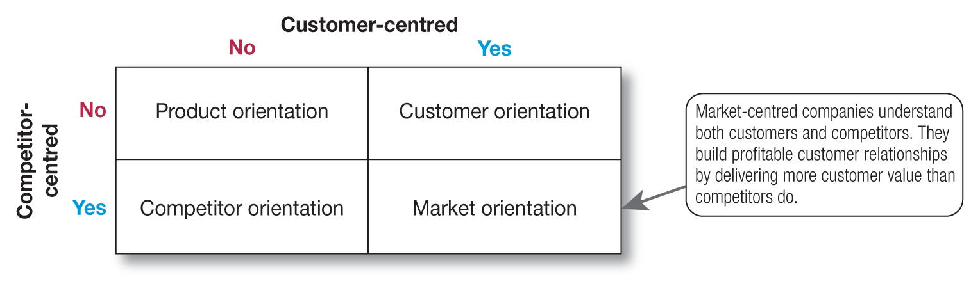
Balancing customer and competitor orientations (Continued)
Notes:
Figure 18.3 Evolving company orientation

